Slide 1
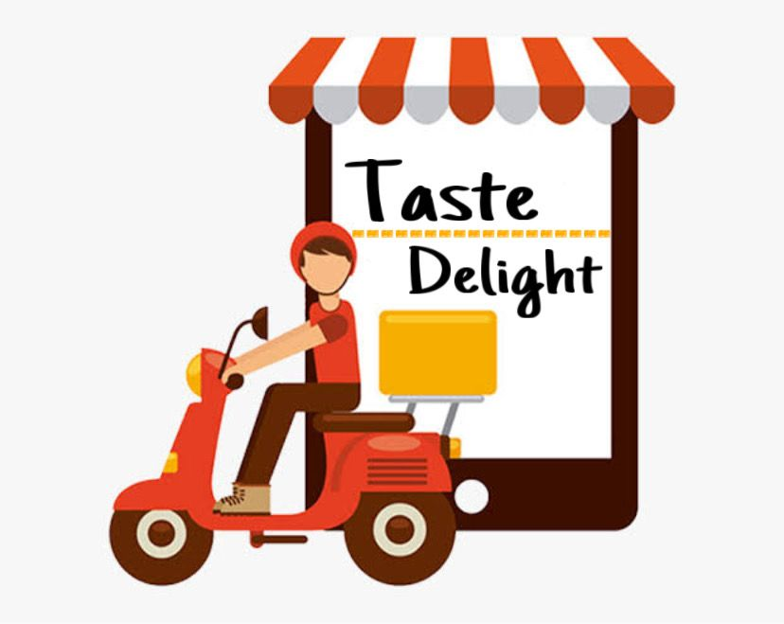
ONLINE FOOD DELIVERY SYSTEM

Slide 2

A
Project on
ONLINE FOOD DELIVERY SYSTEM
A.V. PAREKH TECHNICAL INSTITUTE
COMPUTER DEPARTMENT
Rajkot, Gujarat
Group ID: 07 Internal Guide:
Yagnik Hathaliya.

Slide 3
TOPICS
INTODUCTION
GROWTH, AIM AND OBJECTIVE
FEATURES (ADDITIONAL FEATURE)
ADVANTAGES OF PROPOSED SYSTEM
MODULES AND THEIR WORKING
PROCESS MODEL
USER CHARACTERISTICS
FUNCTIONAL AND NON-FUNCTIONAL REQUIREMENT
FEASIBILITY STUDY
USE-CASE
E-R DIAGRAM
DATA FLOW DIAGRAM
SEQUENCE DIAGRAM
ACTIVITY DIAGRAM
GRAPHICAL USER INTERFACE

Slide 4
INTRODUCTION
Online food delivery has emerged as one of the most fast-placed developments in the e-commerce space. This sector has revolutionized the entire outlook towards the food industry as consumers now have the privilege to choose from a wide variety of cuisines, anywhere, anytime from a range of restaurants listed online. Moreover, customer flexibilities in form of no minimum order value and various payment options like the internet banking, digital wallets and cash on delivery have further enhanced the convenience of all consumer categories. The growing urbanization with easy access to smartphones has accelerated the growth of online food delivery system.

Slide 5
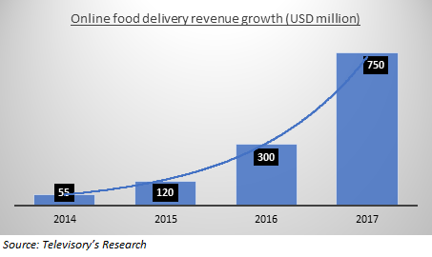
Online Food Delivery Revenue Growth
The Online Food Delivery model has took a great lead in Indian Market, within few years.
Our focus is to develop an Online Food Delivery System which will connect an end-users with each and every restaurants using a vast medium of internet.
The two main components connecting users and sellers are:
1. Creating a website for customer
2. Managing all the aspects of software

Slide 6
WHY??? Online Food Delivery
So basically when we are asked , Why? Online Food Delivery –
The convenience of being able to order food from anywhere and anytime. The convenience of bringing your services to their doorstep. It's the perfect way to eliminate all the physical barriers between your restaurant and the customers, and consequently, make it easier for them to order food from your business.
To begin with, here are a few reasons that make food delivery apps so popular:
The menu is visible and easily accessible within the app.
They offer ordering options for delivery or takeaway.
They offer real-time in-app tracking of the delivery.
Well-designed apps offer great performance for great customer experience.
Restaurants can make use of location-based services, using geo-location notifications to connect with customers.
[LET US SEE THIS FEATURE IN BRIEF.]

Slide 7
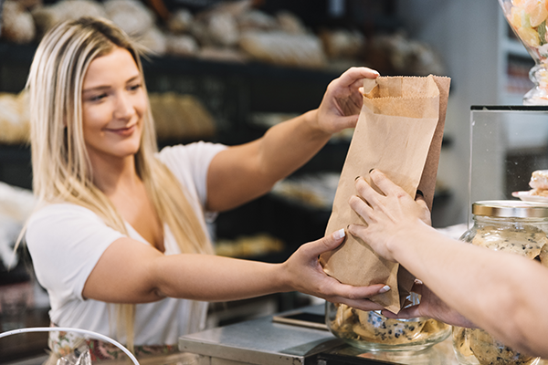
Take Away Ordering
The take away ordering is a win-win solution for restaurant owners and customers. Restaurant owners get paid in advance, they save lot of time as they don’t have to take manual orders over the phone which can even cause errors and confusion. Customers don’t have to wait for the restaurant to answer the phone or ask the pickup time. They can simply go on to the website, see the menu, and place the order for the time they'd like to pick their food.

Slide 8
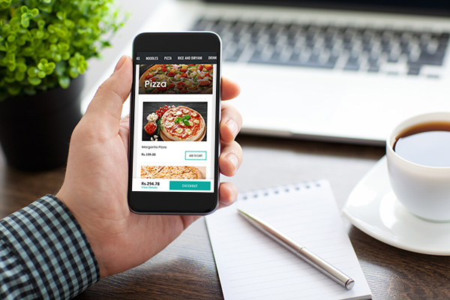
2. Pre-Orders
Many customers like to pre plan their meal and be organized. These customers mostly plan in advance. The pre-order option in Taste Delight allows customers to place orders days or weeks in advance. This feature is helpful to restaurant owners in knowing what they need to keep in stock for that particular date.

Slide 9
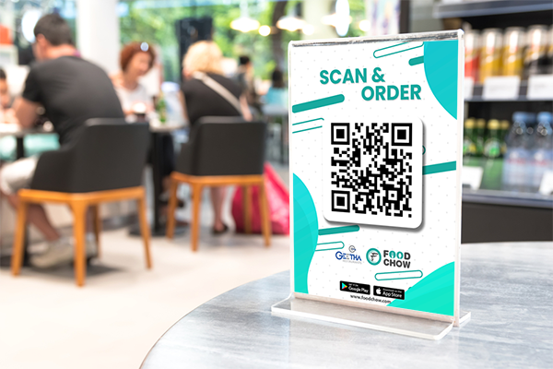
3. Scan & Order
We have developed a very innovative table ordering website to allow customers to place order via smartphone. This solution will help restaurant owners earn thousands of rupees as there'll be no need of order taking staff. This innovative help customers to order from their phone when they are ready, and help restaurant owners in acquiring their customers' valuable information.

Slide 10
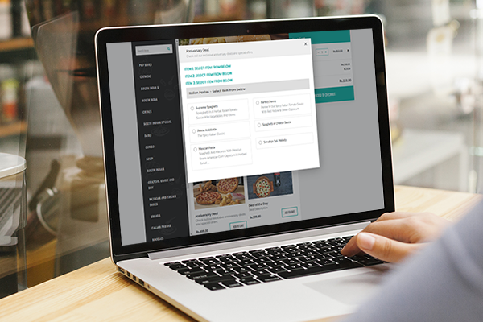
4. Real Time Offers
There are hundreds of websites and tools out there for online delivery and food ordering, but what about tool which can drive customers into your restaurant. Taste Delight real time offers system allows you to run limited time and limited quantity offer for dine in and take away customers during off peak hours. This way you will be able to increase more sales and acquire more customers.

Slide 11

5. Easy To Use & Low Cost
To start your Restaurant Business online is very easy with Taste Delight. Just Few Minutes and you are ready to start.
Fast and Easy to Setup
Start Ordering in Minutes
No Technical Expertise Required
Easy Pricing

Slide 12

6.Delivery Methods
Taste Delight Providing more than one Delivery Method options to Restaurant Owners and Users. Restaurant Owner can provide any or all Delivery Methods among them and also Customer can choose any delivery method to have their food.
Delivery
Take Away/Pick Up
Dine In

Slide 13

ADDITIONAL FEATURE
We have added a new feature in our Food Delivery System, That is we are notifying each customer about their health care.
We have introduced a new topic in it that is we will be taking a note of if any end-user has any of the problem regarding to the health and by that we will be giving them an alert message if anyhow the meal is not suitable for their health.
Despite this we will also provide a health chart by which they can see that what all things are good for their health.
By this at the end of the project we will be able to serve a healthy and amazing website with our likely customer.

Slide 14
ADVANTAGES OF ONLINE FOOD DELIVERY SYSTEM
This will speed up the ordering process.
The system will help to reduce labour cost involved.
This will avoid long queues at the counter due to the speed of execution and number of optimum screens to accommodate the maximum throughput.
The system will be less probable to make mistake, since it’s a machine.
The top benefit of online ordering was a savings in labour, since employees are not tied up on the phone or at the counter.
Order accuracy was another benefit for restaurant.

Slide 15
MODULES
ADMIN
RESTAURANT OWNER
CUSTOMER
DELIVERY MAN

Slide 16
WORKING OF THE MODULE
Admin: Administrator is the main module which manages the project and gives permissions.
Restaurant Owner: Restaurant Owner will add his/her functionalities to the system.
Customer: The actual user or the end-user of the system who will utilize all the functionalities.
Delivery Man: This will provide the meal to the customer and take that from restaurant.

Slide 17
WHAT IS PROCESS MODEL
Iterative Waterfall Model is the extension of the Waterfall model.
This model is almost same as the waterfall model except some modifications are made to improve the performance of the software development.
The iterative waterfall model provides customer’s feedback paths from each phase to its previous phases.
There is no feedback path provided for feasibility study phase, so if any change is required in that phase then iterative model doesn’t have scope for modification or making corrections.
Iterative waterfall allows to go back on the previous phase and change the requirements and some modification can done if necessary.
This model reduces the developer’s effort and time required to detect and correct the errors.
In iterative waterfall model, next phase can only begins when the previous phase is completed as waterfall model.

Slide 18
Feasibility Study
Requirement Analysis
Design
Coding
Testing
Maintenance

Slide 19
WHY TO USE THIS MODEL
We are preferred to use iterative waterfall model for our system because in our projects where quality is more important as compared to schedule or cost. It is easy to understand and implementation. And also, the requirements are well defined and clearly understood.

Slide 20
ADVANTAGES
Simple and easy to understand and use.
Phases are processed and completed at one time.
Clearly defined stages.
Works well for smaller projects where requirements are very well understood.
Easy to arrange task.
Process and results are well documented.

Slide 21
USER CHARACTERISTICS
Taking responsibilities
Verifying system details
Handling system details
Ensuring every other module
ADMIN

Slide 22
USER CHARACTERISTICS
Coordinating with staff
Observing and preparation and serving of food
Maintaining inventories
Adhering to food safety regulations
RESTAURANT OWNER

Slide 23
USER CHARACTERISTICS
USER CHARACTERISTICS
Interact with system
Plays role as an end user
Achieve special privileges
Orders the meal
CUSTOMER

Slide 24
USER CHARACTERISTICS
USER CHARACTERISTICS
Gets an order request
Deliver the meal to the customer
Goes to desire location
DELIVERY MAN

Slide 25
Provides occasional Services
Provides menu
Order History
Gains payment from admin
Sign up
Login
Order History
Advertisement
Manage Feedback
View Order
Payment Mode
Assign Delivery Person
Manage Category
Login
Functional Requirement
of Admin
Functional Requirement
of Restaurant Owner

Slide 26
View Product
View category and schemes
Checkout
Add to cart
Sign up
Login
Place Order
Tips
Ratings
Track order
Send Feedback
View order history
Verify the placed order
Gains Payment
Delivery Method
Updating status
Sign Up
Login
Functional Requirements of Delivery Person
Functional Requirements of Customer

Slide 27
Safety
Compatibility
Performance
Cost
NON FUNCTIONAL REQUIREMENT

Slide 28
FEASIBILITY STUDY
Server Side Hardware
Server Side Software
Hardware | Minimum Requirement
RAM: | 256 MB
Hard Disk Space: | 5 GB of available hard disk space
Processor (CPU) Speed: | Pentium II 300-MHz-or-compatible processor
Graphics Card: | Video graphics adapter that can support 256 colors and a resolution of 800 by 600 dpi
Network Adapter: | A network adapter from the Microsoft Windows Server 2003 Hardware Compatibility List
Software | Minimum Requirement
Operating System: | Windows 2003 Server OR Linux Server Edition OR Unix Server Edition
Web development environment: | Wampp (Windows Platform) OR Xampp (Unix Platform) Lampp (Linux Platform)

Slide 29
FEASIBILITY STUDY
Client Side Hardware
Client Side Software
Hardware | Minimum Requirement
RAM: | 128 MB
Hard Disk Space: | 1.5 GB of available hard disk space
Processor (CPU) Speed: | Pentium 233-MHz-or-compatible processor
Graphics Card: | Video adapter and monitor with Super VGA (800 x 600) or higher resolution
Network Adapter: | A network adapter from the Microsoft Windows Xp Hardware Compatibility List
Software | Minimum Requirement
Operating System: | Windows XP OR Later OR Linux / Unix Variant
Browser: | Internet Explorer (8 or Later) OR Google Chrome (1.0 or Later) OR Mozilla Firefox (1.5 or later)

Slide 30
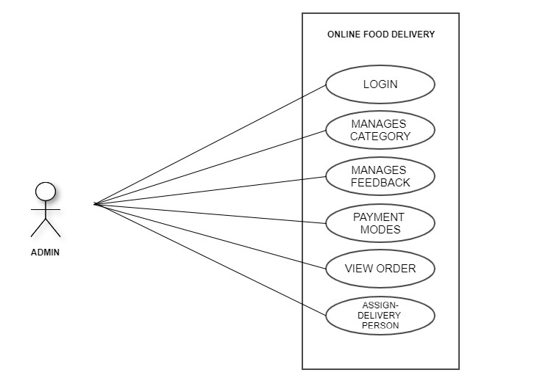
USE CASE FOR ADMIN

Slide 31
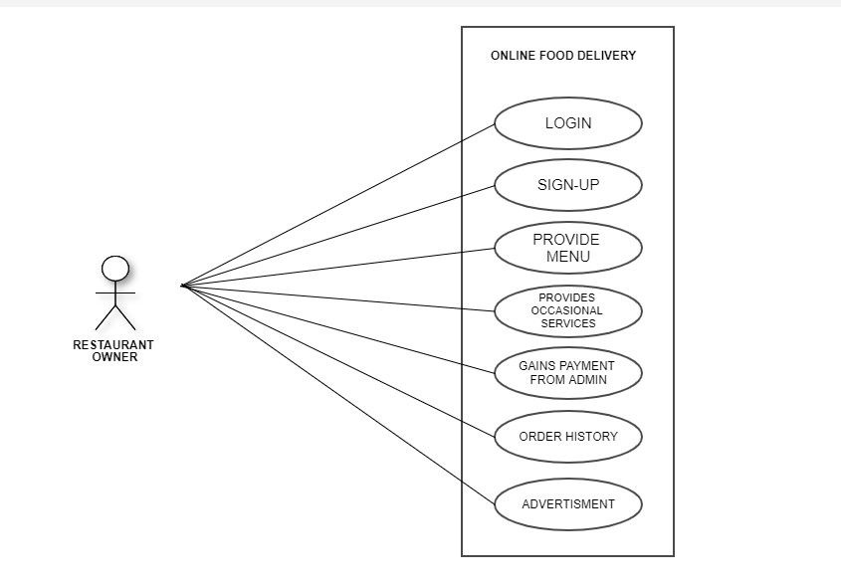
USE CASE FOR RESTAURANT OWNER

Slide 32
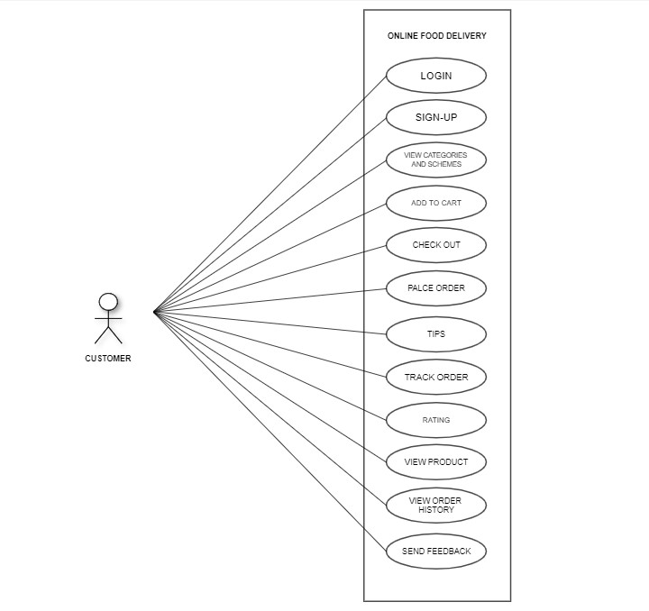
USE CASE FOR CUSTOMER

Slide 33
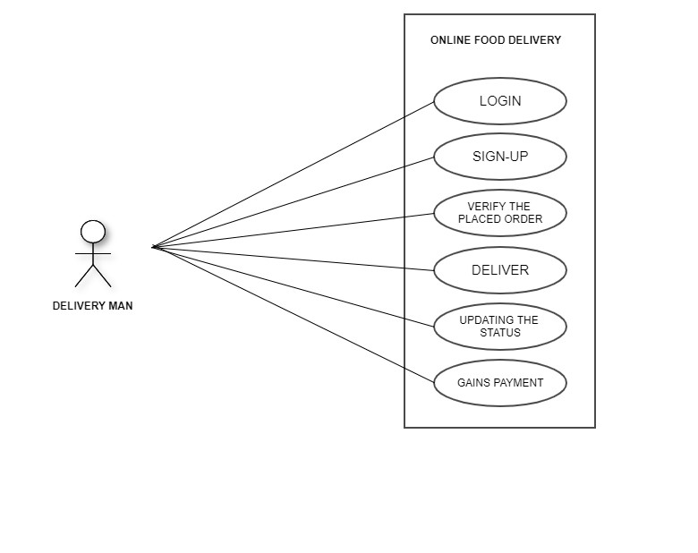
USE CASE FOR DELIVERY MAN

Slide 34
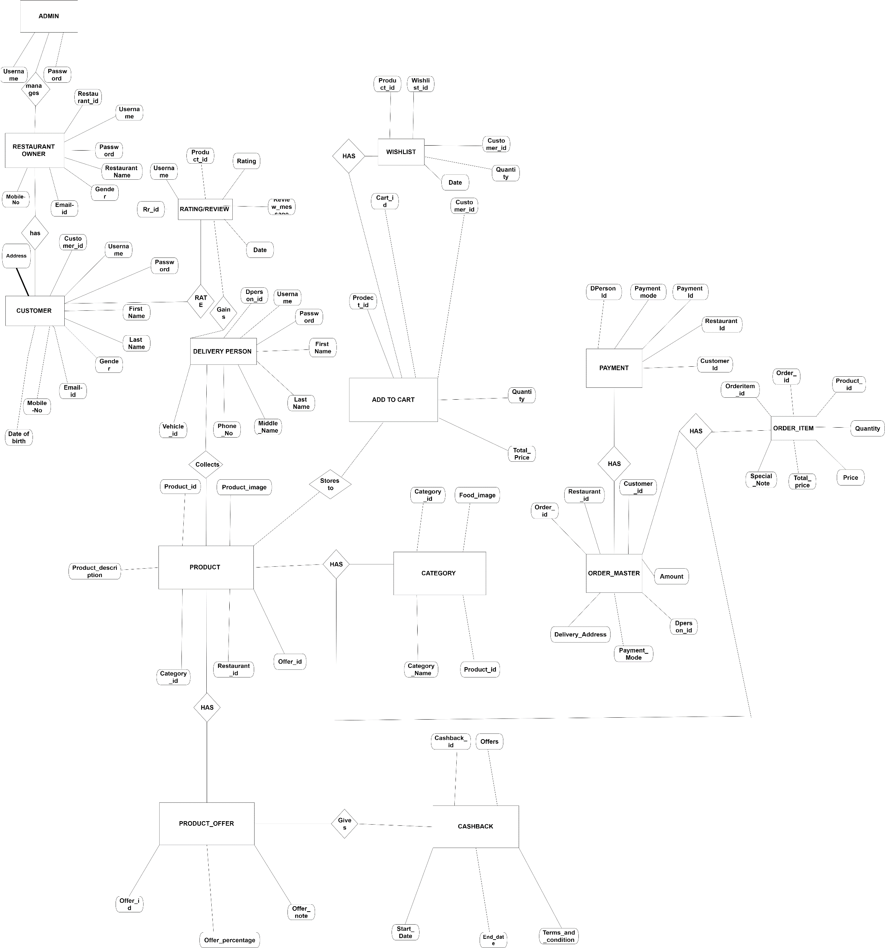
E-R DIAGRAM OF OUR SYSTEM

Slide 35
CONTEXT LEVEL DFD DIAGRAM

Slide 36
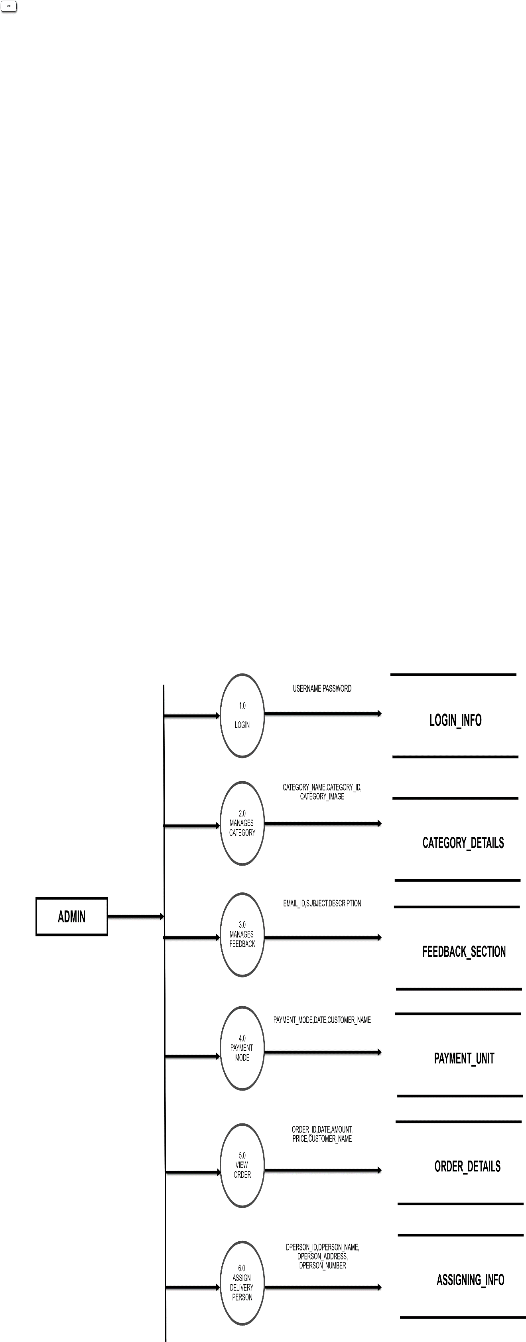
DFD LEVEL-1 DIAGRAM FOR ADMIN

Slide 37
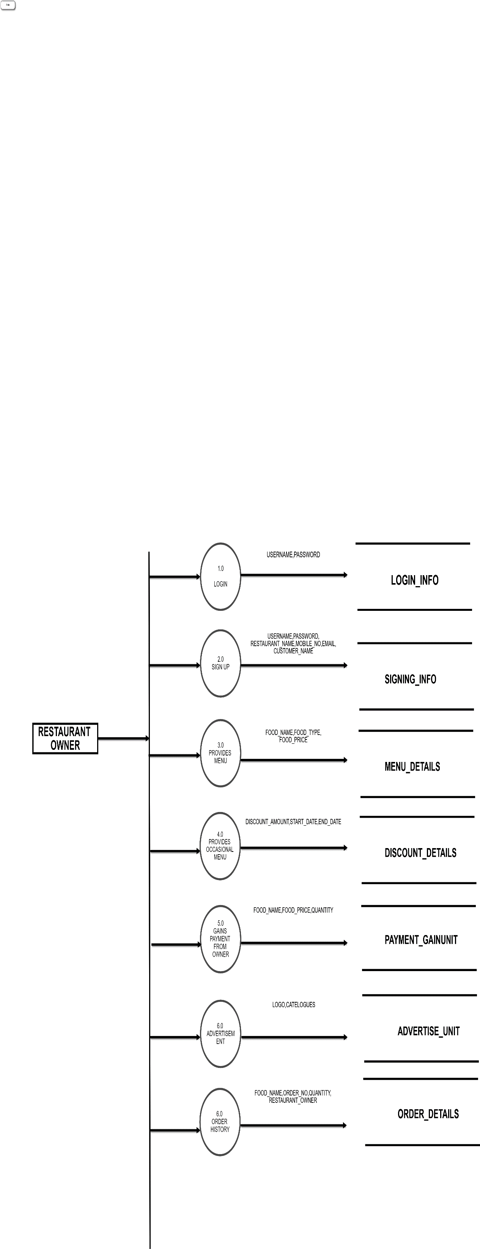
DFD LEVEL-1 DIAGRAM FOR RESTAURANT OWNER

Slide 38
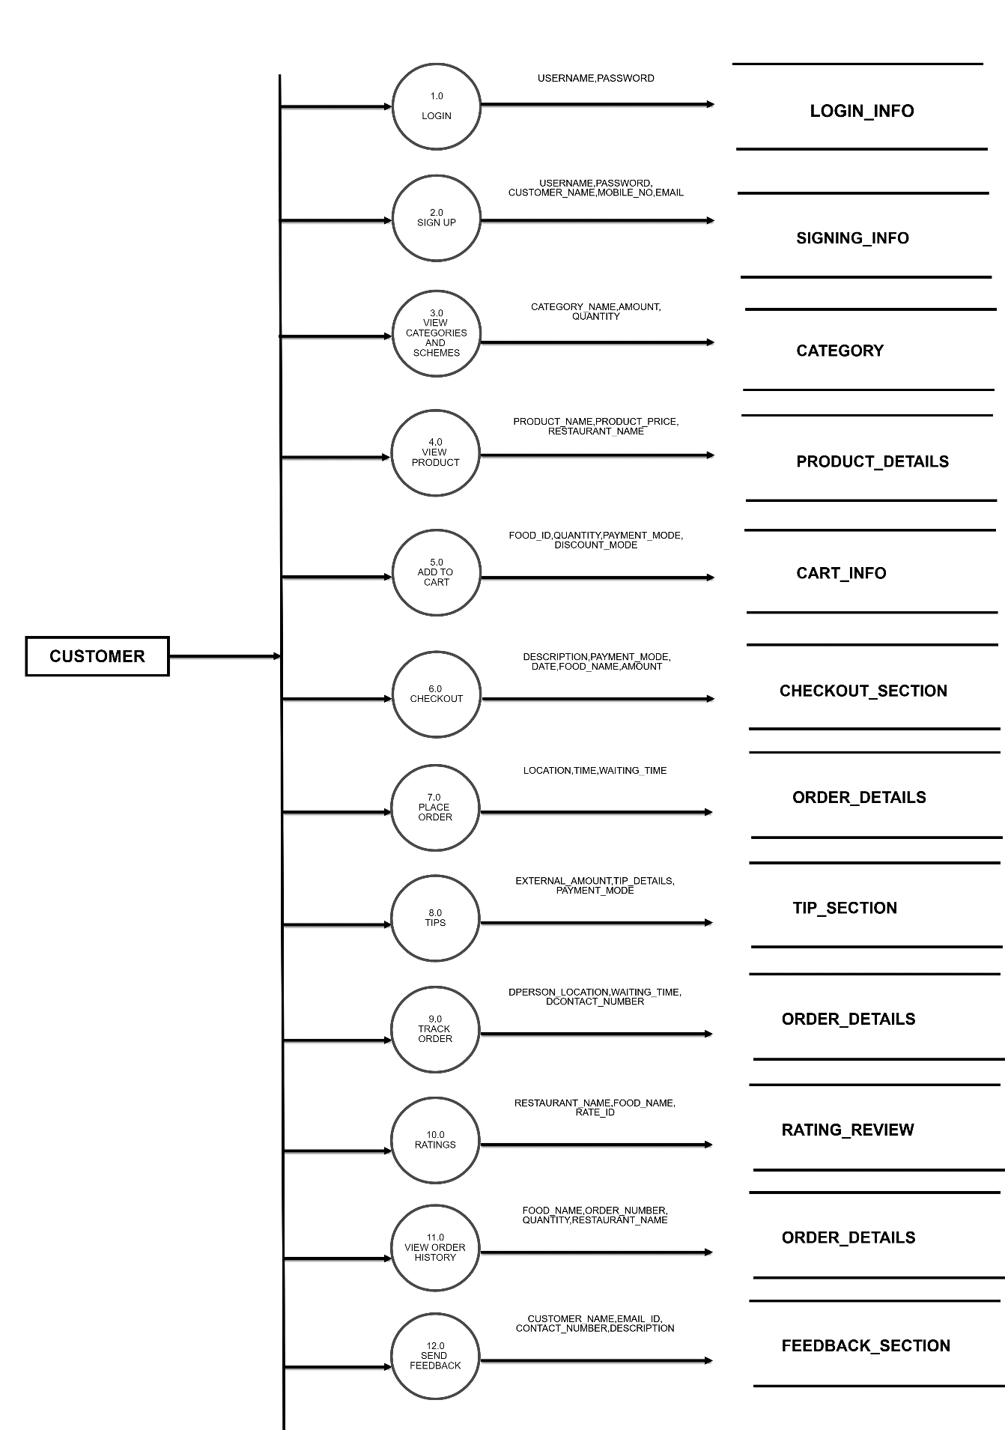
DFD LEVEL-1 DIAGRAM FOR CUSTOMER

Slide 39
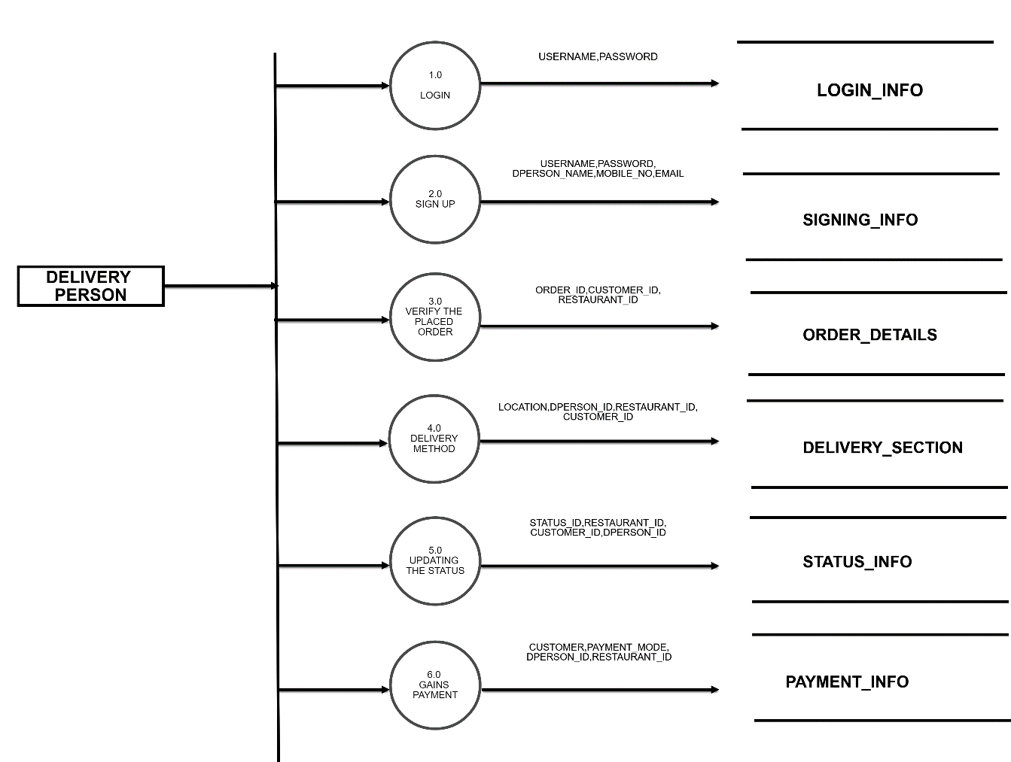
DFD LEVEL-1 DIAGRAM FOR DELIVERY MAN

Slide 40
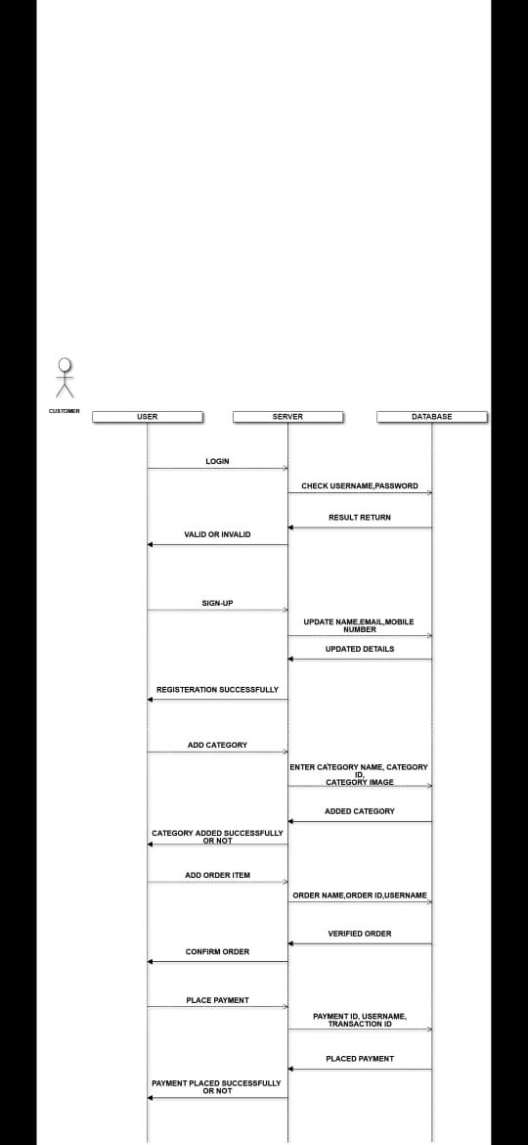
SEQUENCE DIAGRAM

Slide 41
ACTIVITY DIAGRAM FOR ADMIN

Slide 42
LOGIN
ACTIVITY DIAGRAM FOR RESTAURANT OWNER
CHECK_INFO
VALID
MANAGES
CATEGORIES
VIEW
ORDER
SAVE ORDER
SAVING
ORDER
PAYMEN
ENTER DETAILS
T MODE
PROVIDE TIME
CHECK
REQUIRED

Slide 43
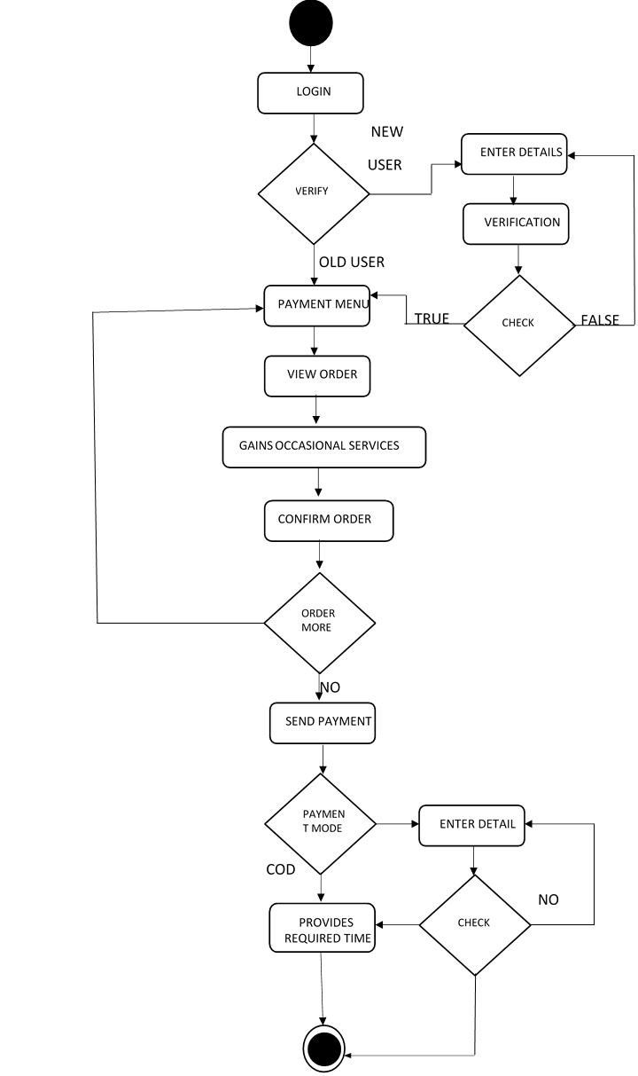
ACTIVITY DIAGRAM FOR CUSTOMER

Slide 44
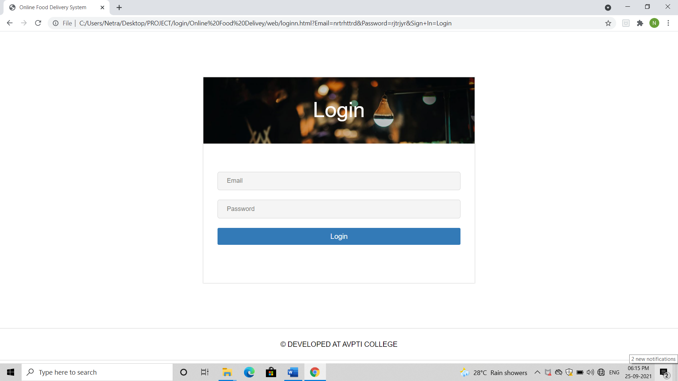
LOGIN FORM

Slide 45
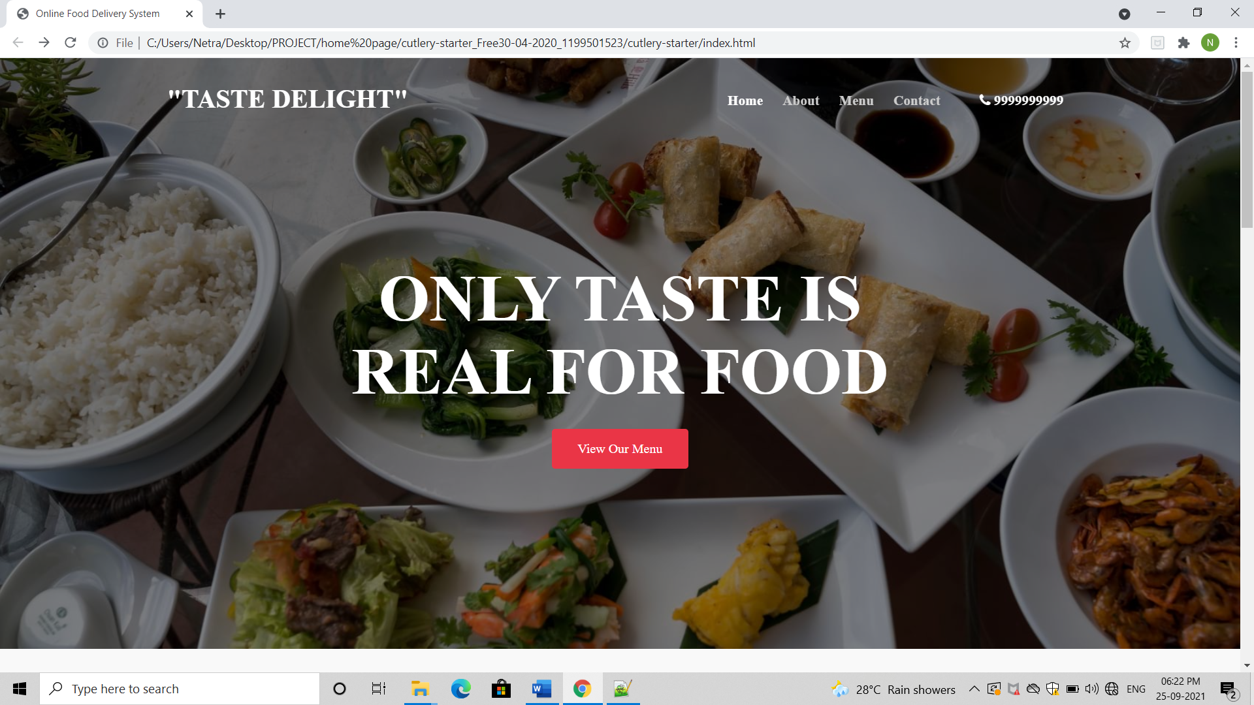
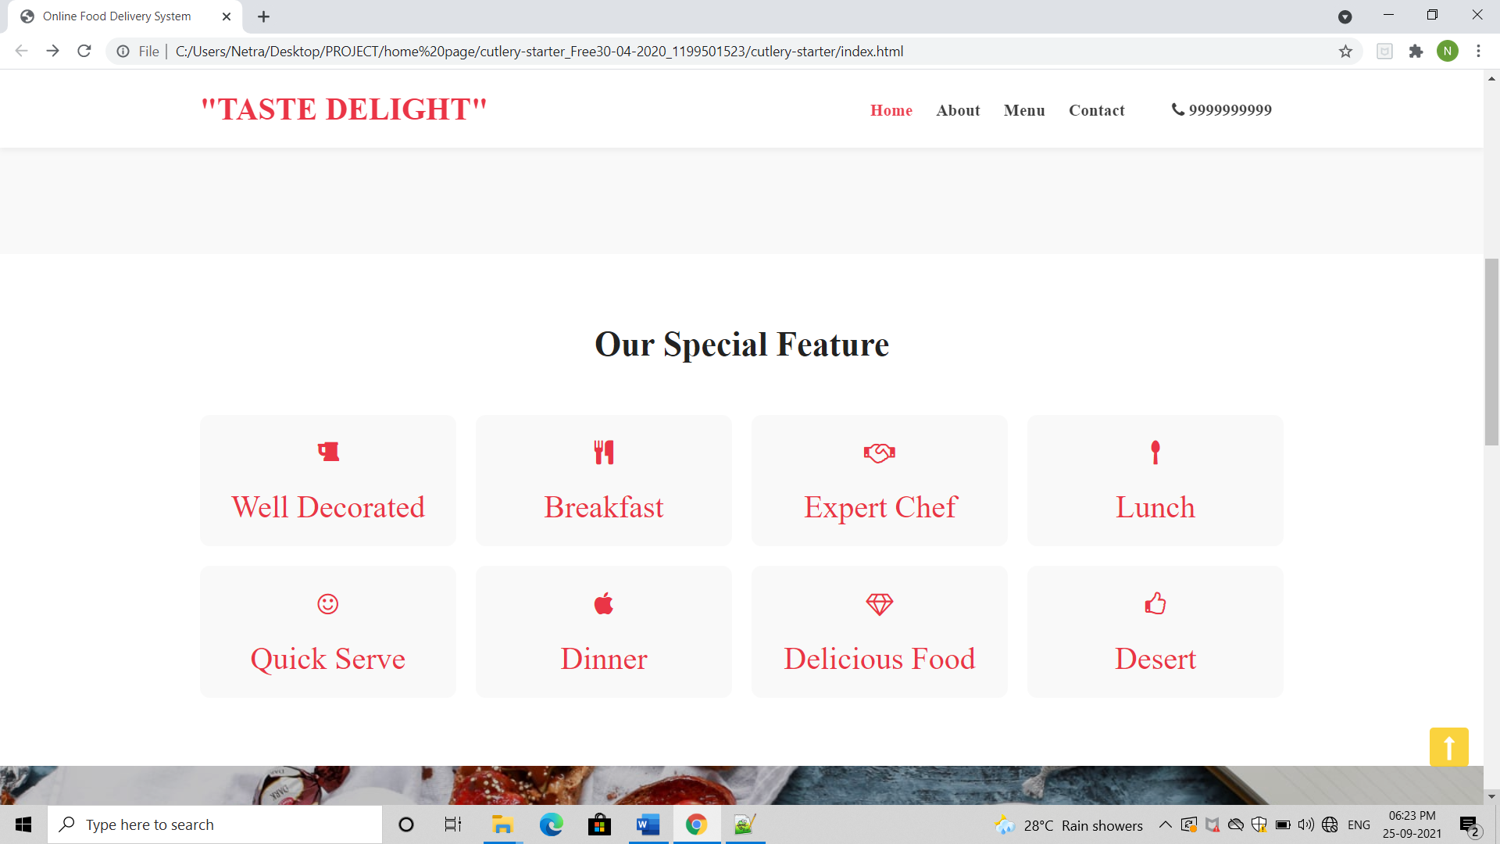
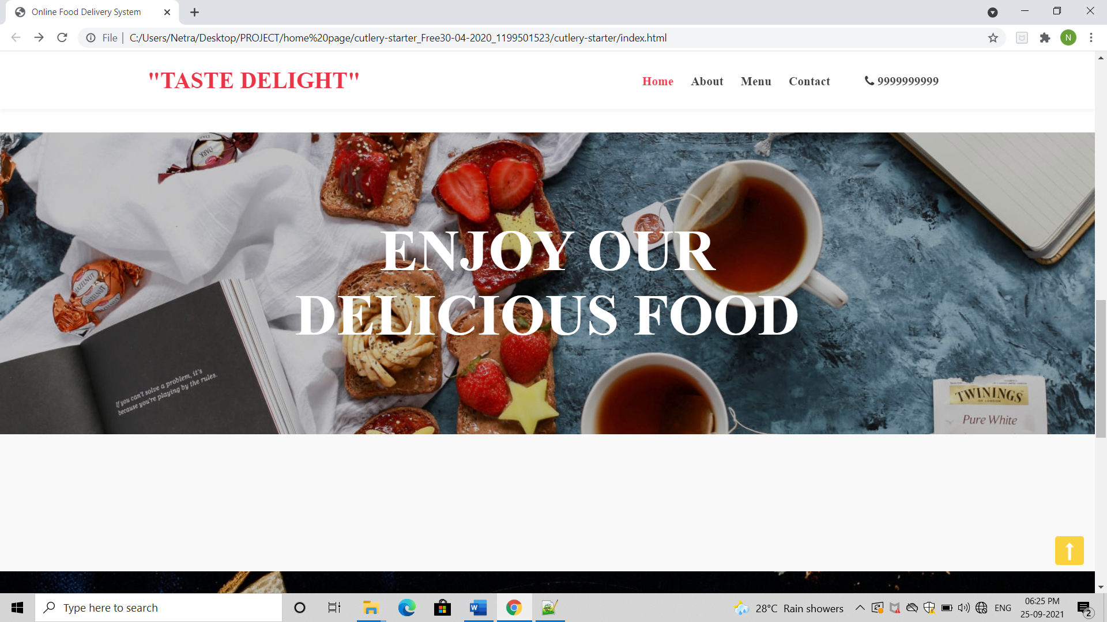
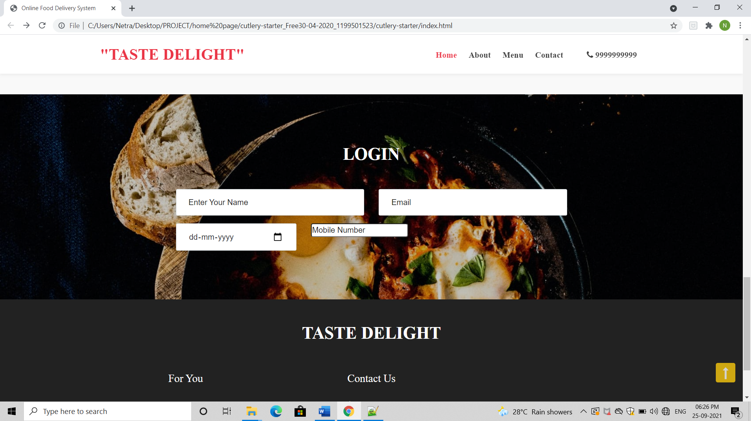
HOME PAGE

Slide 46
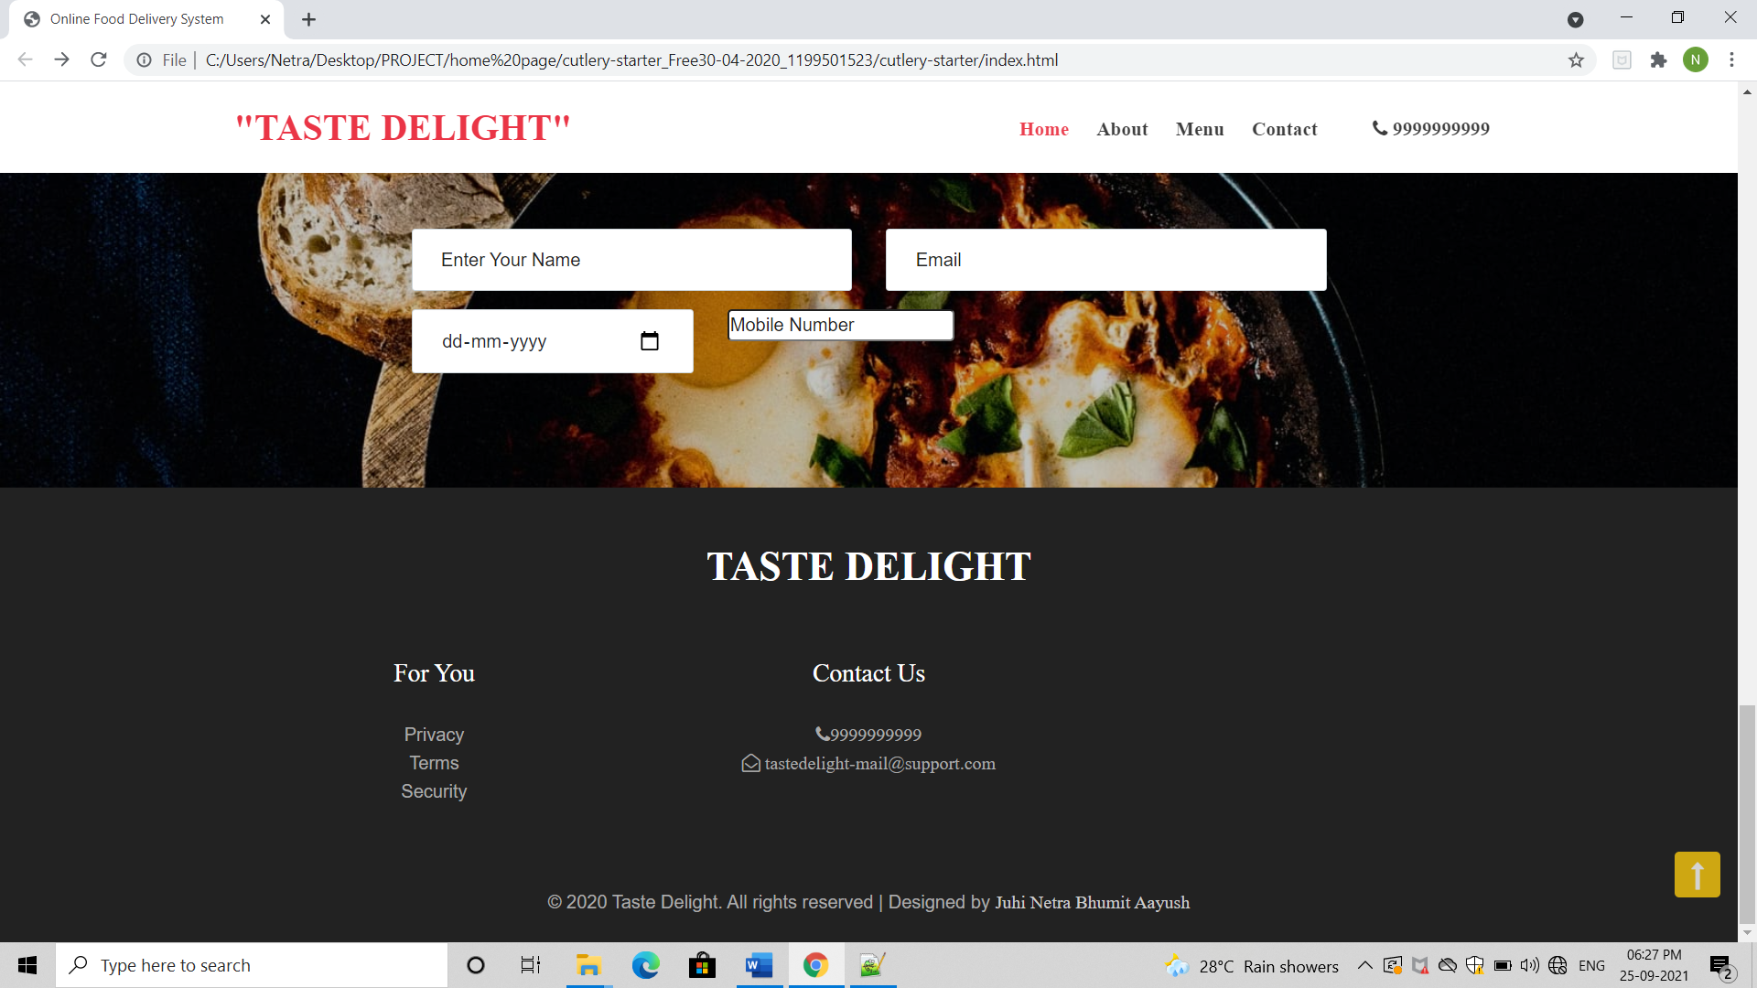
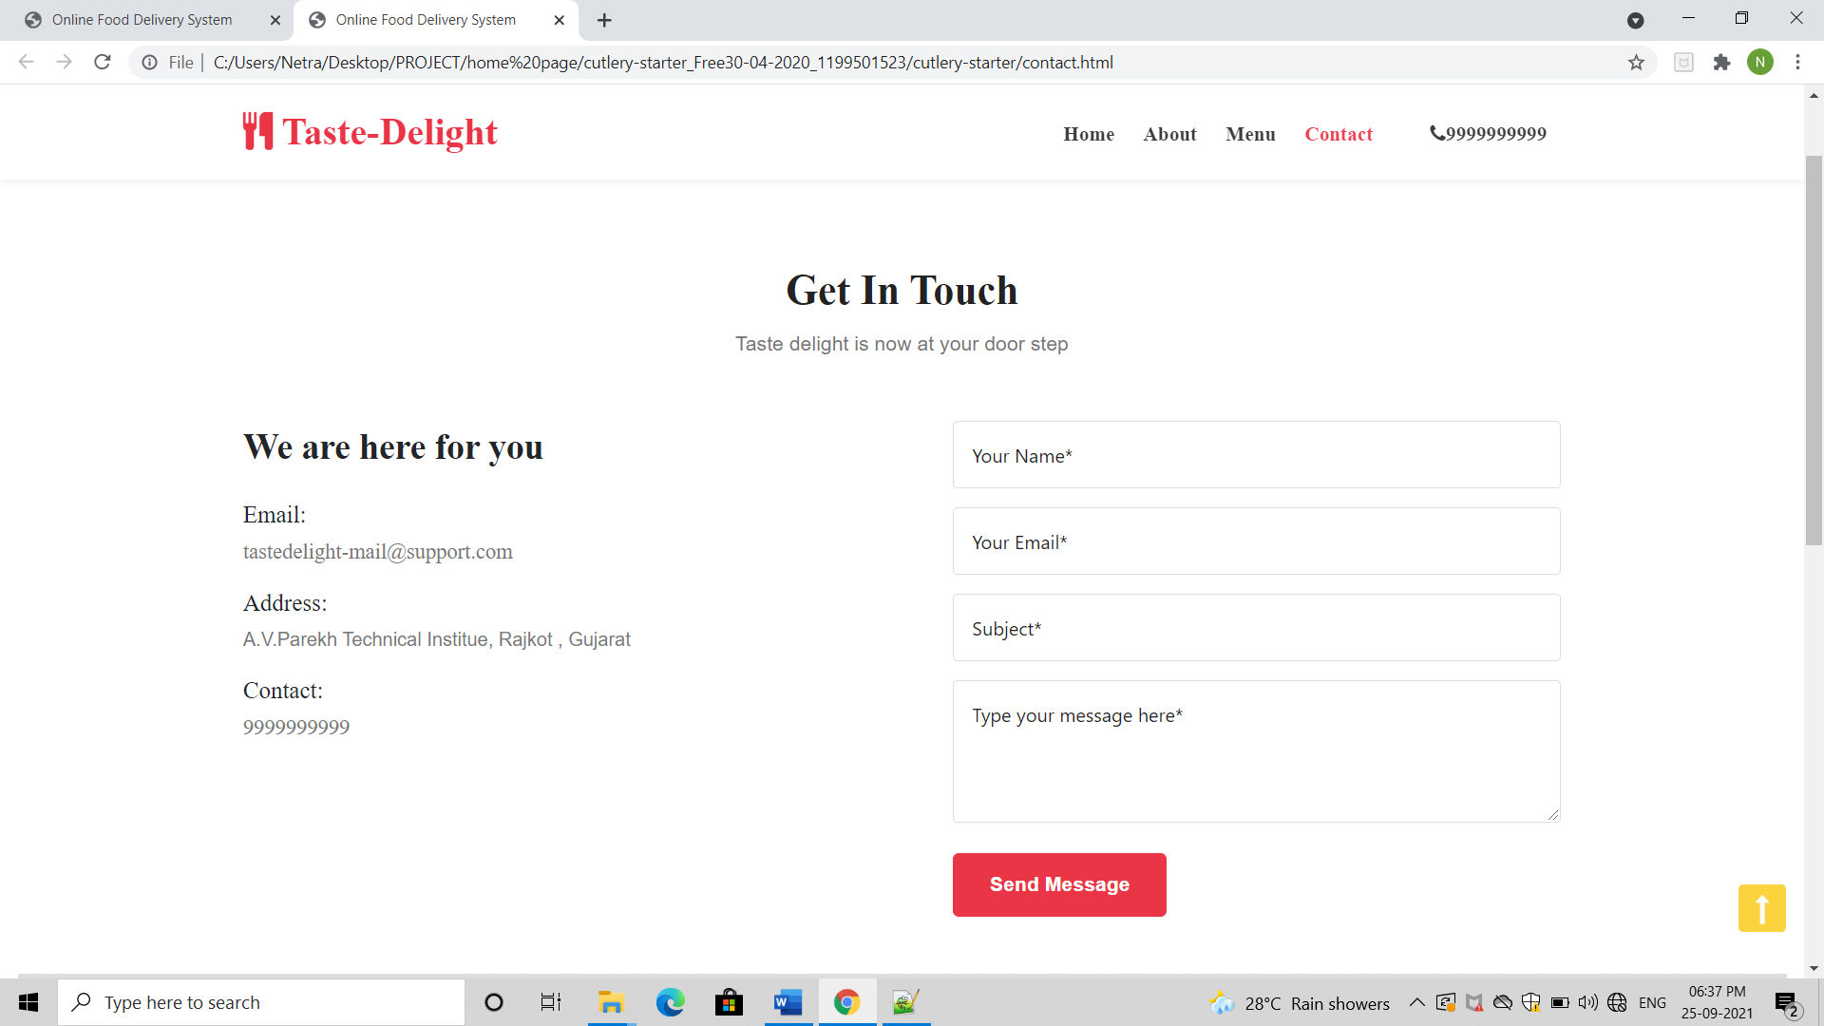
RATINGS AND REVIEW
CONTACT US

Slide 47
REFERENCES
https://www.geeksforgeeks.org/
https://projectworlds.in/
https://en.wikipedia.org/wiki/Data-flow_diagram
https://www.tutorialspoint.com/

Slide 48
THANK YOU
Bhumit Boraniya D. 196020307017
Jadav Netra P. 196020307524
Shah Aayush A. 196020307556
Vibhakar Juhi P. 196020307575

